Slide 1
Add Risk & Actions form Part 1, 2, 3
Menu items
Config user roles
High level stats e.g. my actions pending and overdue
Validate New Risks
Filtered register for pending validation
Access risk summary and accept/reject
Menu items
Config user roles
High level stats e.g. my actions pending and overdue
Home
View Register
Menu items
Config user roles
High level stats e.g. my actions pending and overdue
Add and Update Risk
Add Risk
Modify Risk
View all details
Assign Risk Owner
my actions
Update Actions
Risk specific actions
View my actions
Update my Actions
Re-assign Action Owner
View Action by Risk
Allow many actions per risk
Update Action
Update Actions
Assign / Modify Action Owner

Slide 2
Add Risk – anyone (form part 1)
Threat or Opportunity
Project
WBS
Risk Title
Risk Description
Risk Cause
Risk Consequence
Project (Dropdown)
Type (Dropdown)
Add data
Set Approval status to pending
If user has Admin rights then allow to proceed to full data entry
WBS (Dropdown)
Title (Textbox)
Description (Textbox)
Cause (Textbox)
Consequence
Proximity
Cancel
Submit

Slide 3
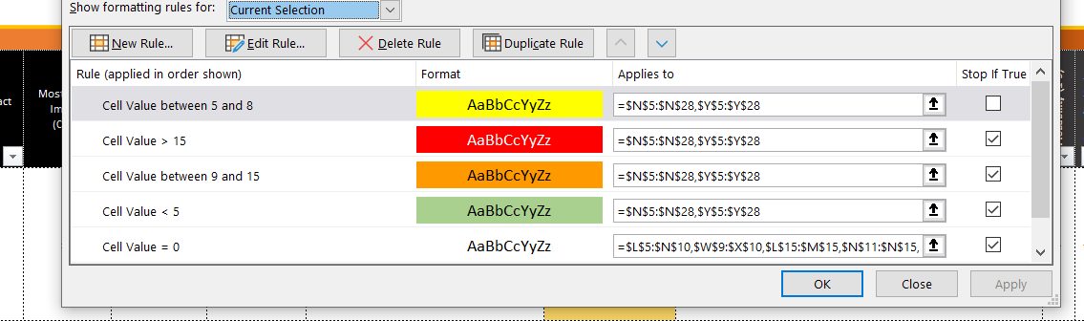
Add Risk as Admin or Edit Risk (form part 2)
Ref
Probability
Manageability
Probability (1-5)
Severity (1-5)
Risk Rating (1-25)
Prob (%)
Min Impact (Cost)
Most Likely Impact (Cost)
Max Impact (Cost)
Current Risk Value*
Justification
Severity
Probability
Add data
Set status to unassessed
Need assessment popup for risk rating – edit as single button
Risk Rating
Severity
Prob %
Risk Rating
Min £
Comments
Likely £
Status
Manageability
Probability (1-5)
Severity (1-5)
Risk Rating (1-25)
Max £
Current £
Comments/Updates
Status Open / Closed
Date Closed
Date Reviewed
Justification
Cancel
Submit

Slide 4
Add / Edit Actions (form part 3)
Edit Actions
Popup to edit action detail and status
Action Detail
Edit
Action Detail
Edit
Action Detail
Edit

Slide 5
Validate New Risks
Edit item detail, update data, approve or reject
Items view filtered to show unassessed items
Filter to show rejected
Facility to correct data. Option to continue editing as full assessment
Item Detail
Edit
Item Detail
Edit
Item Detail
Edit

Slide 6
Register
Edit item detail, update data with current assessment; add actions; update actions
Use same register screen as initial validation
Visibility of last reviewed data – RAG based on duration last reviewed?
Item Detail
View / Edit
Item Detail
View / Edit
Item Detail
View / Edit

Slide 7
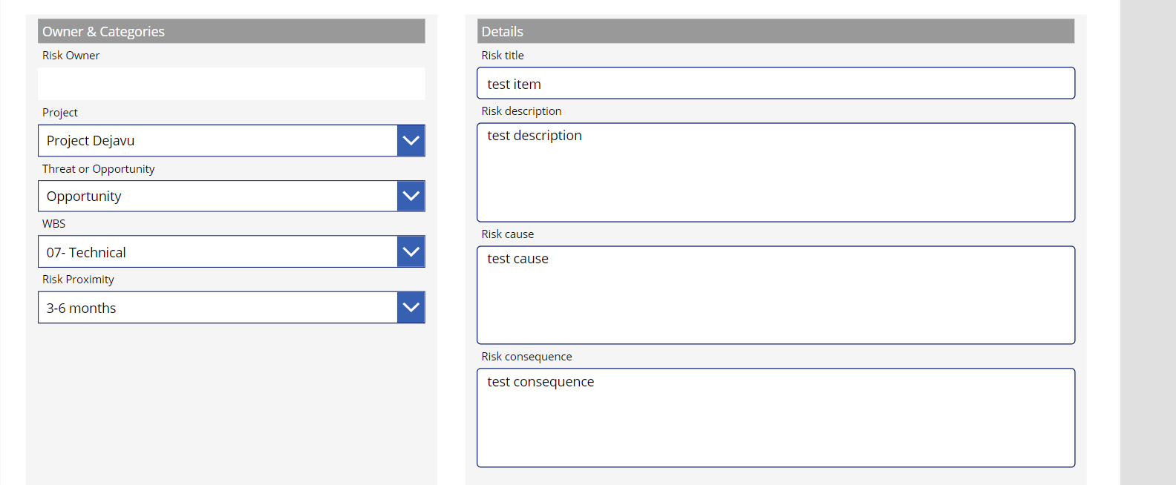

Slide 8
